Slide 1
Version Control System & Collaboration Tools
Quan Vuong
Trainer

Slide 2

Agenda
Version Control concepts
Version Control tools
GIT basics
Branches on GIT
Tools in GIT
SVN basics and tools
Games

Slide 3
Course Audience and Prerequisite
The course is for freshers and newcomers
The following are prerequisites to Version control and Collaboration tools:
Windows
Computer skills
File management
Teamwork

Slide 4
Course Objectives
At the end of the course, you will have acquired sufficient knowledge to:
Understand the Version control concepts, tools and workflows
Manage the version of source code or files on GIT and SVN repositories
Practice the basic operations on Version control system
Do the branching and merging on Version control repositories

Slide 5
Version Control Concepts

Slide 6
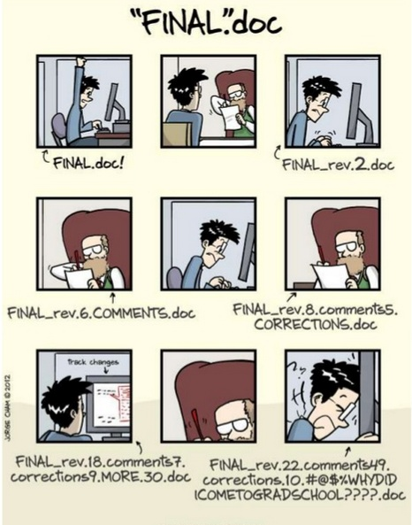
Scenario
Notes:
Asking questions

Slide 7

What is Version Control?
Method to centrally store files
Record a copy per change
Log who, when, where, what
Recover files if something wrong
Also called as revision control / source control

Slide 8
Why Version Control?
Ability to back-up
Integrate sources / sub systems
Collaboration with other people
Troubleshooting
Productivity

Slide 9

How it helps you …
Change code in small steps
Log changes in versions
Feel safe when changing code
Easy to try out things

Slide 10
How it helps team...
Allow team to work on same source base
Handle collision by merging function
Answer who did what
Team work productivity

Slide 11
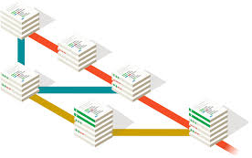
Version Control System
Tool to manage file changes
Three types
Localized (tren may tinh, xai rieng cho minh, ko lam nhom dc)
Centralized(can co server)
Distributed(upgrade cua3 Centralized)
Also called
Revision control software
Version management software
Source control software
Configuration management software

Slide 12
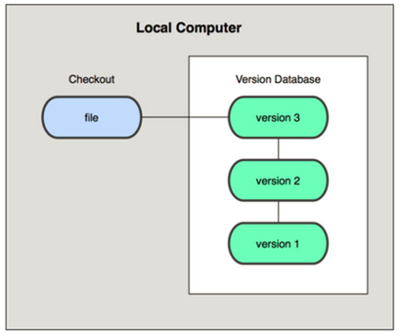
Localized Version Control System
Check out files on Local computer
Notes:
A simple database that kept all the changes to files under revision control

Slide 13
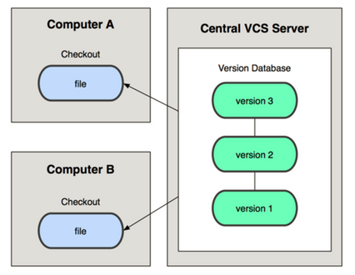
Centralized Version Control System
Check out files from Remote server
Notes:
People needed to collaborate with developers on other systems - a single server that contains all the versioned files. e.g. CVS, Subversion, Perforce
If the server goes down, nobody can collaborate or see different versions.
If the drive in the server is corrupted, everything is lost.

Slide 14







Centralized Tools
Notes:
client-server model, developers use a shared single repository

Slide 15
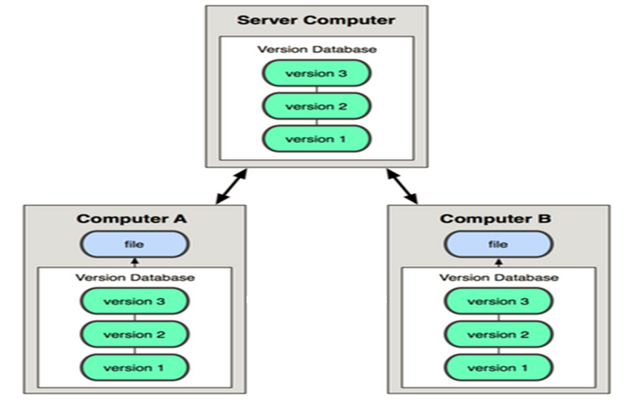
Distributed Version Control System
May A, B co the share tai lieu cho nhau neu Server die
Check out files from Server or from peer
Notes:
Clients fully mirror the repository. Thus if any server dies, and these systems were collaborating via it, any of the client repositories can be copied back up to the server to restore it. Every checkout is really a full backup of all the data.

Slide 16





Distributed Tools

Slide 17
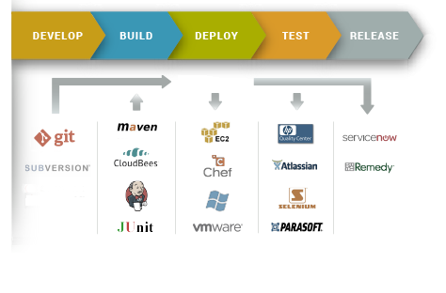
Version Control in Real World
Continuous Integration (CI) process

Slide 18
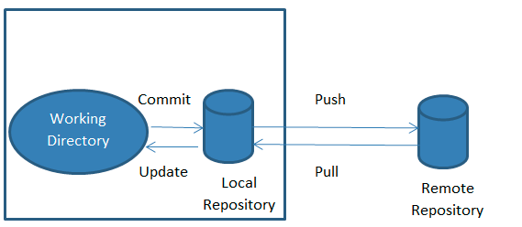
Version Control Vocabulary
Repository
Server
Client
Working Copy
Version control basic operation
Notes:
Repository Where files’ current and historical data are stored.
• Server A machine serving the repository.
• Client The client machine connecting to the server.
• Working copy Local copy where the developer changes the code.

Slide 19
Basic Operations
Add
Change
Commit
Revert
Update
Tags
…
Version control basic operation

Slide 20
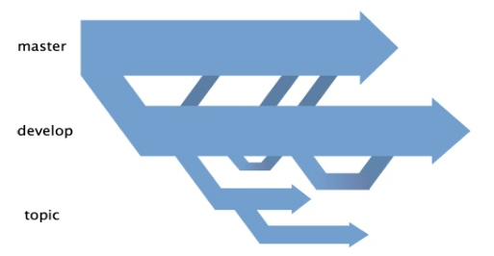
What is branch?
Copy of current tree / workspace
Support parallel development
Notes:
Co the tach cac nhanh ra de code tiep

Slide 21
Version Control Tool GIT

Slide 22
GIT
Distributed Version Control System
Multiple redundant repository
Each dev have a copy of repository & history
Community support and use widespread currently
Reference at https://git-scm.com/downloads

Slide 23
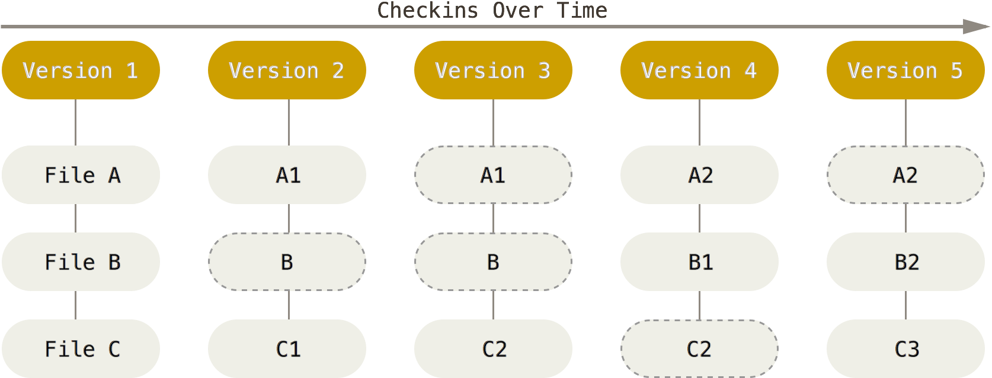
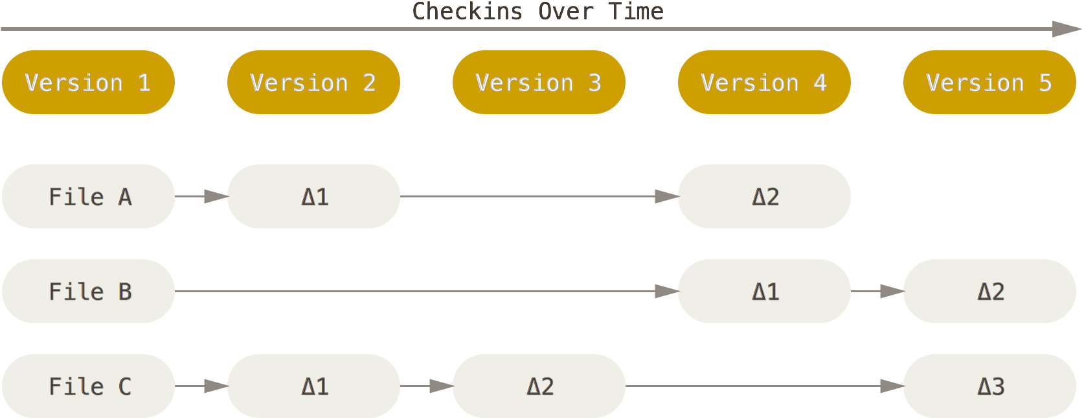
GIT & Not GIT behavior
Stores Snapshot of files
Stores List changed files (NOT GIT)
GIT check in (top) and not GIT check in (bottom)

Slide 24
Why GIT?
Best branching & merging mechanism
Work offline(lam ko can server cung dc)
Easy switch, no checkouts
Data Assurance
Undo mistake
Free Opensource

Slide 25
Git Basics

Slide 26
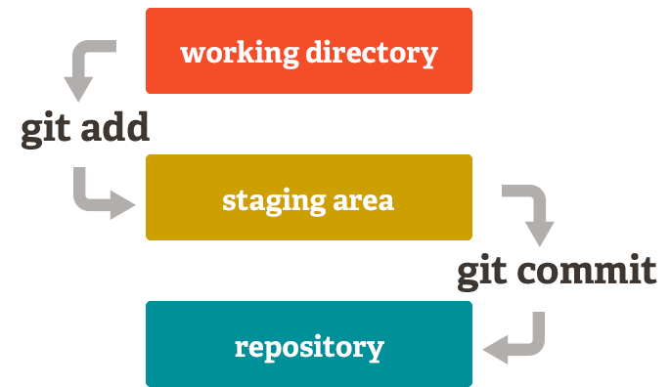
The three stages of GIT
The basic Git workflow:
Create: You get files in your working directory.
Stage: adding snapshots of them to your staging area.
Commit: takes the files in the staging area and stores that snapshot permanently to your Git directory.
GIT commit workflow
Notes:
Toi day van chua len server. Moi dua len repository (tren may, local).
Khi bam push no moi dua len server

Slide 27
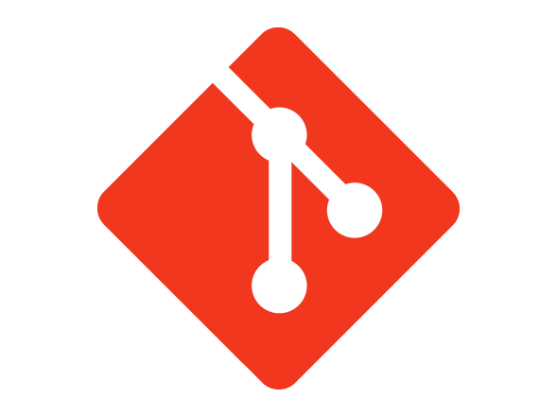
GIT Common Basic Commands
Add
branch
checkout
clone
commit
diff
init
log
merge
pull
push
status
rm
mv
Add file a:
git add a
Commit file a:
git commit –m ‘add a’
Push file a to server:
git push origin master
GIT basic commands

Slide 28
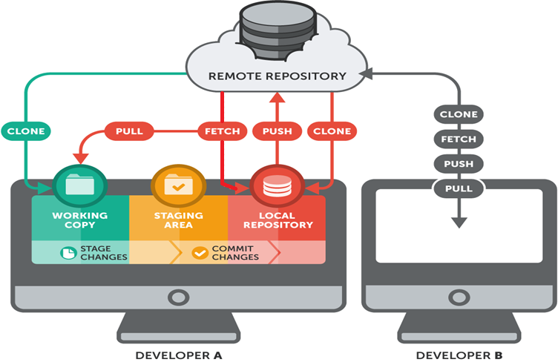
GIT workflow
GIT clone, fetch, push and pull from server

Slide 29
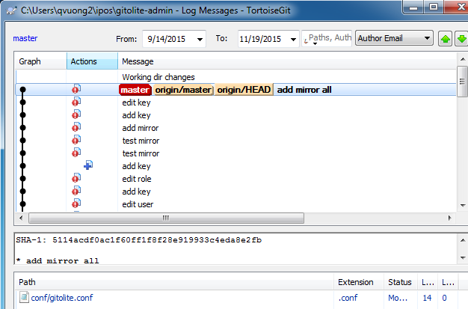
Git Basics - Viewing the Commit History
How to view history
Limit log output
Use GUI to visualize history

Slide 30
Git Basics
Summary
Know how to create repository
How to make, stage and commit changes
Ways to view the history of changes

Slide 31
Branches on Git

Slide 32
Branches on Git
What is branch?
A branch is a lightweight movable pointer to the commits
The default branch name is master
Create a branch
Create and check out a new branch: git checkout –p test
Switch to an existing branch
Check out ‘master’ branch: git checkout master
Notes:
IM MMMMMMMMMMMMMMMMMMMMMMMPORTTANT

Slide 33
Branches on Git – Merging
Merging
Combine two branches,i.e: master and test
Command on master branch: git merge test
Resolving merge conflicts
Control the different between two branches.
Managing branches
Show branches with command: git branch

Slide 34

Git Branches
Default Branch
master
Create new branch
git branch develop-v1
Create and switch to new branch
git checkout –b develop-v3
Switch to branch and merge existing branch as well
git merge develop-v3 master
Notes:
Swith lai b1: git checkout develop1

Slide 35
Branches on Git
Summary
Covered basic branching and merging in Git.
Create, switch between branches and merge / rebase local branches
Share branches by pushing them to a shared server

Slide 36
Tools in Git
Notes:
you’ll see how to work with Git in a distributed environment as a contributor and an integrator. That is, you’ll learn how to contribute code successfully to a project and make it as easy on you and the project maintainer as possible, and also how to maintain a project successfully with a number of developers contributing.

Slide 37

Git Installation
Download TortoiseGit from URL:https://tortoisegit.org/download/
Choose your version 32bit or 64bit OS.
Double click TortoiseGit-1.8.15.0-64bit.msi to install it.

Slide 38
Git Demo
Create and manage a file version on Git repository
Notes:
Clone a repository from Git server
Create a new file
Add to local repo and commit to staging area
Push to Git server
Pull/fetch repository from server
Branching and Merging

Slide 39
Version Control Tool Subversion

Slide 40

Subversion - SVN
A centralized system with core repository
Designed as compelling replacement for localized
Command includes checkout, commit, update…
Several features:
Not file repository but database
Version not file-based
Directory based tags and branches
Download at http://tortoisesvn.tigris.org/

Slide 41
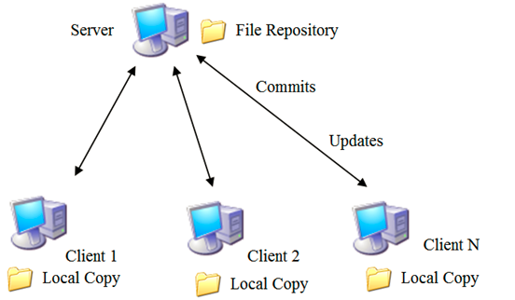
Hierarchy
Client server model

Slide 42
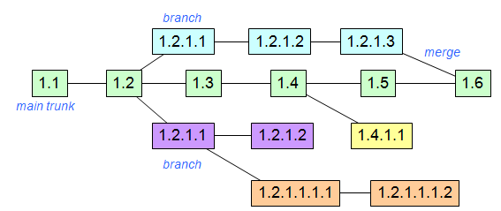
SVN - Steps
File history tracked by revision numbers
Each revision has a log entry
SVN branch and trunk
Notes:
The history of each file is tracked with an incrementing revision number
For each revision there is a log entry
Revision numbers have the format 1.3 if they’re on the main trunk, branches have something like 1.2.1.1

Slide 43
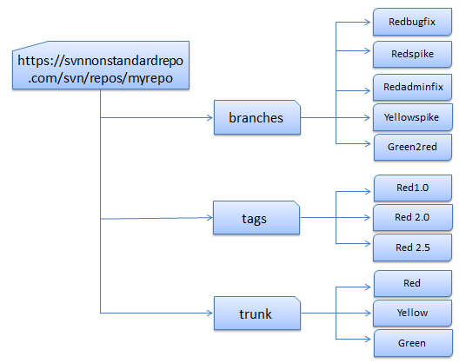
Branches and Tags
SVN repo with branches, trunk, tags
Notes:
Trunk: The main development area. This is where your next major release of the code lives, and generally has all the newest features.
Branches: Every time you release a major version, it gets a branch created. This allows you to do bug fixes and make a new release without having to release the newest - possibly unfinished or untested - features.
Tags: Every time you release a version (final release, release candidates (RC), and betas) you make a tag for it. This gives you a point-in-time copy of the code as it was at that state, allowing you to go back and reproduce any bugs if necessary in a past version, or re-release a past version exactly as it was. Branches and tags in SVN are lightweight - on the server, it does not make a full copy of the files, just a marker saying "these files were copied at this revision" that only takes up a few bytes.

Slide 44
Sample Commands
$ svn checkout [URL]
$ svn add [file/directory]
$ svn delete
$ svn commit
$ svn update
$ svn mv(move)
$ svn help
$ svn diff
$ svn revert
$ svn list

Slide 45
SVN Installation
Download TortoiseSVN from http://tortoisesvn.net/downloads.html
Choose your version 32bit or 64bit OS.
Double click TortoiseSVN-1.9.2.26806-x64-svn-1.9.2.msi to install it.

Slide 46
SVN Demo
Create and manage a file version on SVN repository
Notes:
Clone a repository from SVN server
Create a new file
Add and commit to SVN server
Branches and tags

Slide 47
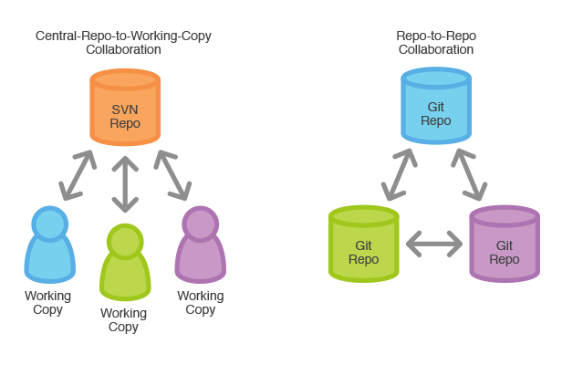
Git and SVN comparison
Git operates more faster
Storage at database
Git more advantages than SVN
Distributed approach
Centralized vs Distributed

Slide 48

Summary
Version Control
Method to centrally store files
Log who, when, where, what
Also called as revision control / source control
Three types of VCS:
Localized
Centralized (SVN)
Distributed (GIT)
GIT vs SVN
Git operations more faster
Storage at database
Distributed approach

Slide 49
References
Version Control
https://en.wikipedia.org/wiki/Revision_control
SVN
http://tortoisesvn.net
GIT
https://git-scm.com/downloads

Slide 50
Thank you! Q & A

Slide 51
Games

Slide 52

Games
Clone ‘test’ repo from git@20.203.6.65:test to your local machine.
Create a new file in the cloned repo.
Add and commit to remote repo.
Push file to Git server.

Slide 53
Revision History
Date | Version | Description | Updated by | Reviewed and Approved By
Aug 10, 2015 | 0.5 | Ready for review | Thien Tran | Quang Tran
Nov 26, 2015 | 1.0 | Ready for review | Quan Vuong | Quang Tran

Slide 54


